Slide 1
IP Enabled Ride-on
Powered by Cisco IoX
Paul Beyleveld
Consulting Systems Engineer
September 2016

Slide 2
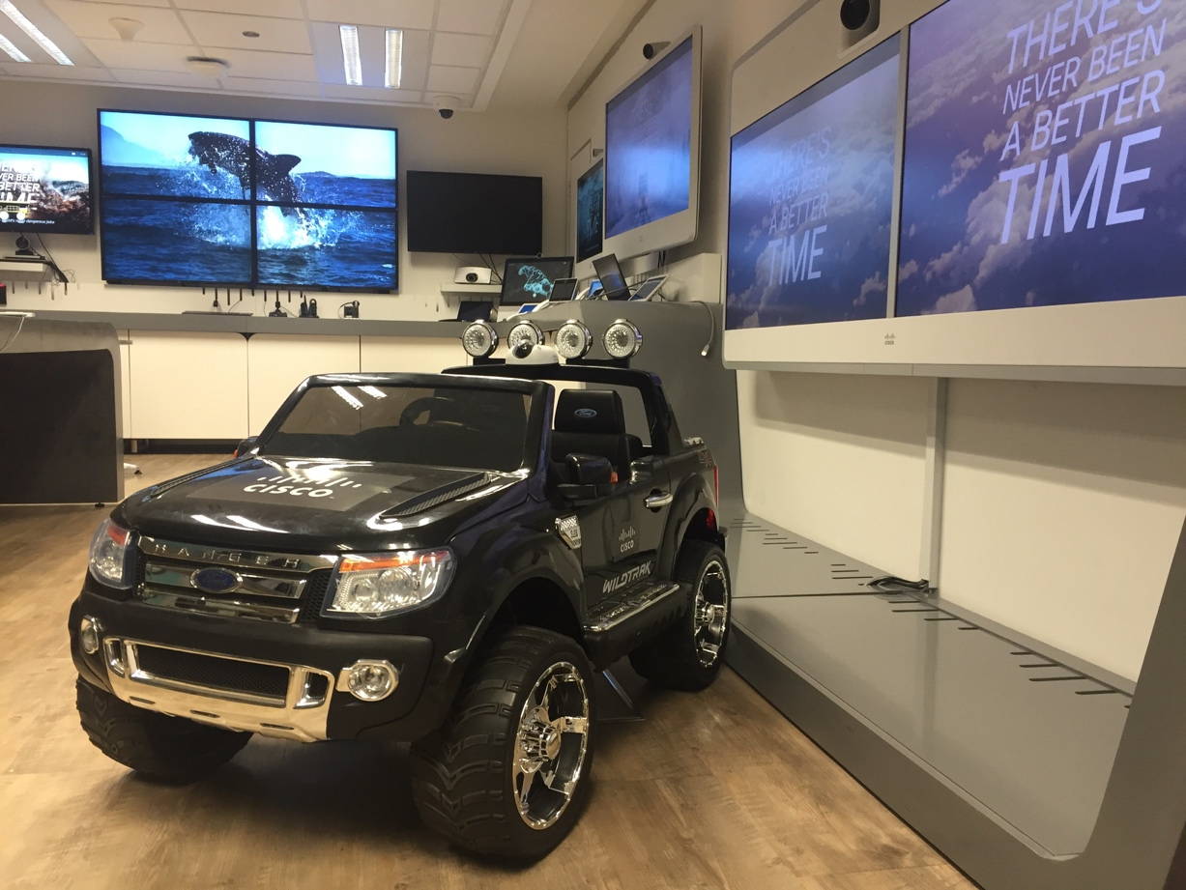
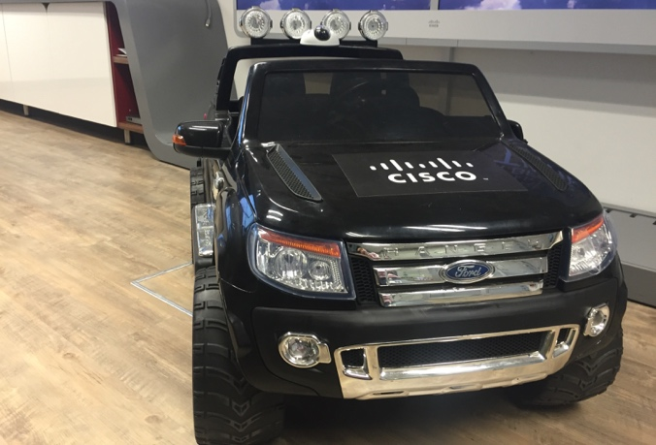
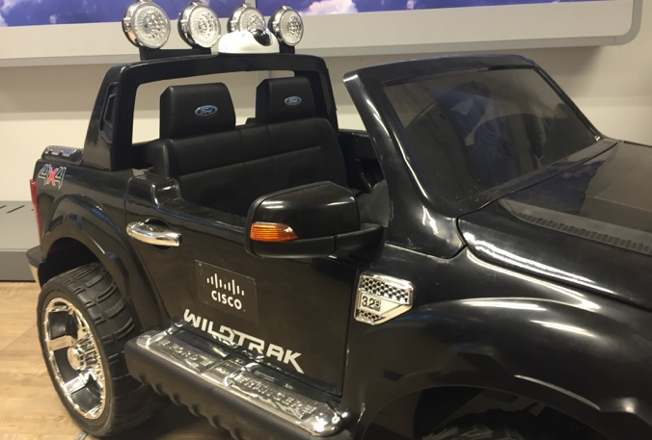
Cisco IP Enabled Ride-on

Slide 3
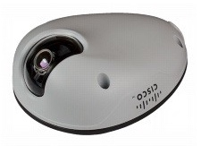
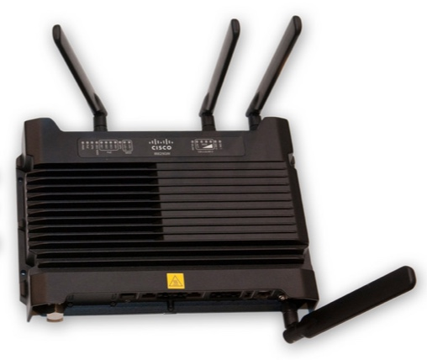
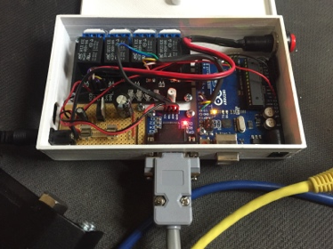

The Tech
Cisco IP Camera
Cisco 6050
Cisco IR829
Custom Electronics

Slide 4
Demo

Slide 5
Cisco IR 8xx Platform Architecture
Virtual Machine
Virtual Machine
Virtual Machine
PaaS
App
IOx
IOS
Hypervisor
IR829/809 Hardware

Slide 6

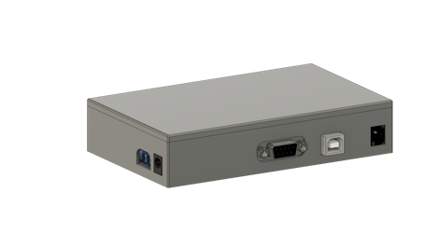
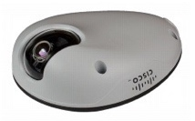
Conceptual Design
Virtual Machine
Virtual Machine
Virtual Machine
PaaS
App
IOx
IOS
http
Hypervisor
Serial
hardwired
IR829
Car Controller
rtsp
Ride-on
Wifi User
IP Cam

Slide 7
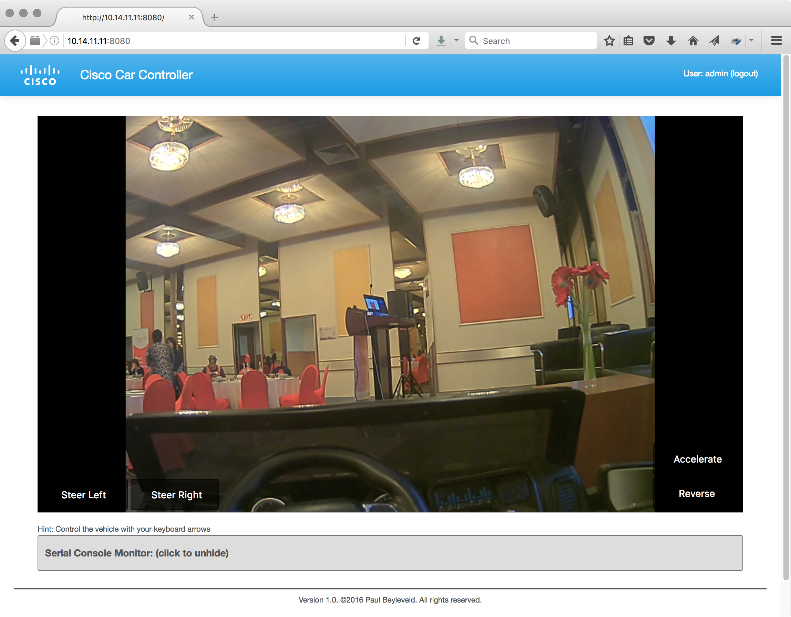
Car Control PaaS App
Python HTTP Server
HTML5 App
Authenticate users
Grab Session ID from IP Camera
Websocket
Javascript maps keyboard and buttons clicks into car instructions
Serial Worker Threads
Receive commands from web socket
Issue/read commands over over serial

Slide 8
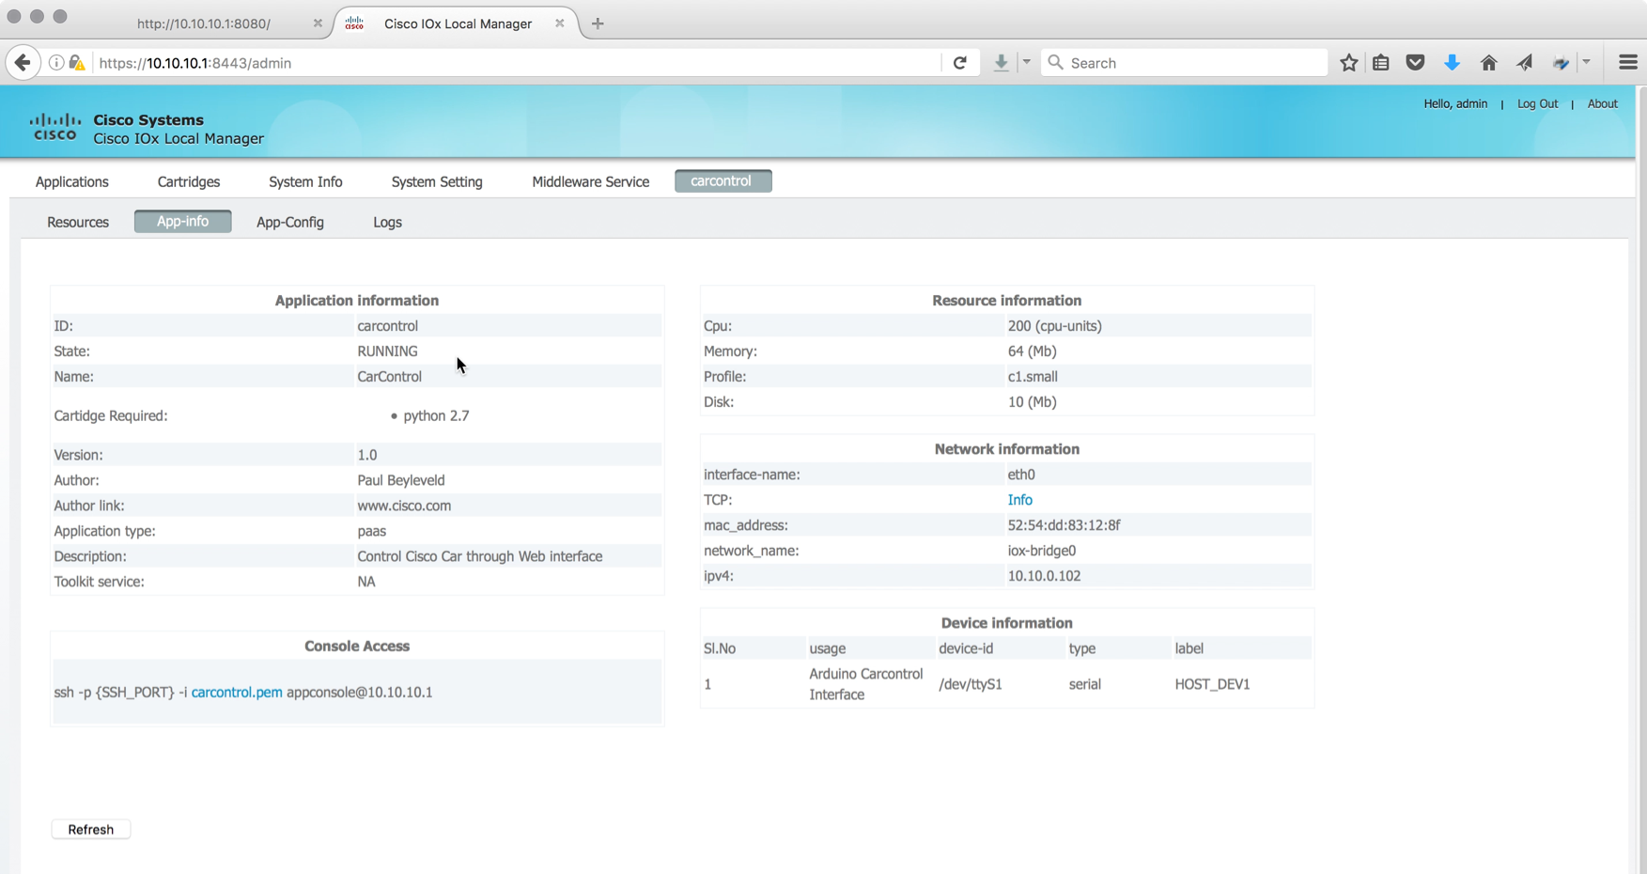
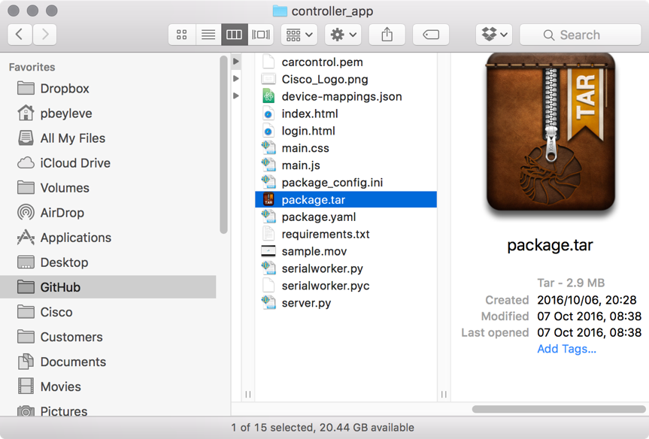
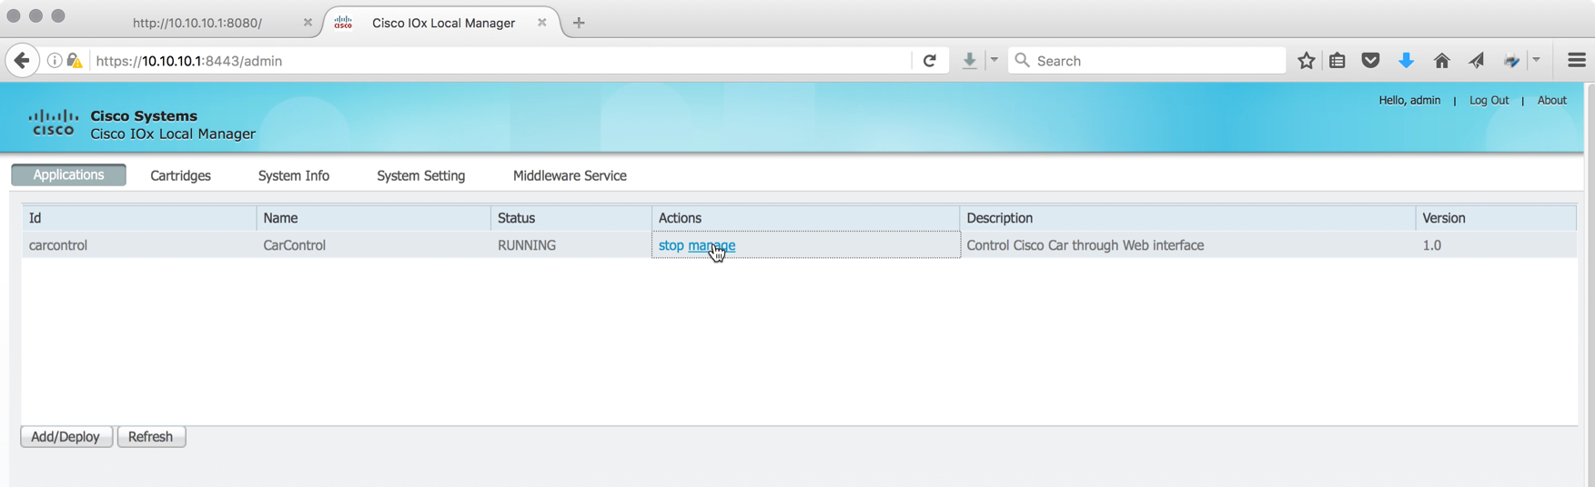
Car Control PaaS App
Resources
Packaged for deployment
Deployed on Router
App Info
Mapped Serial Interface

Slide 9
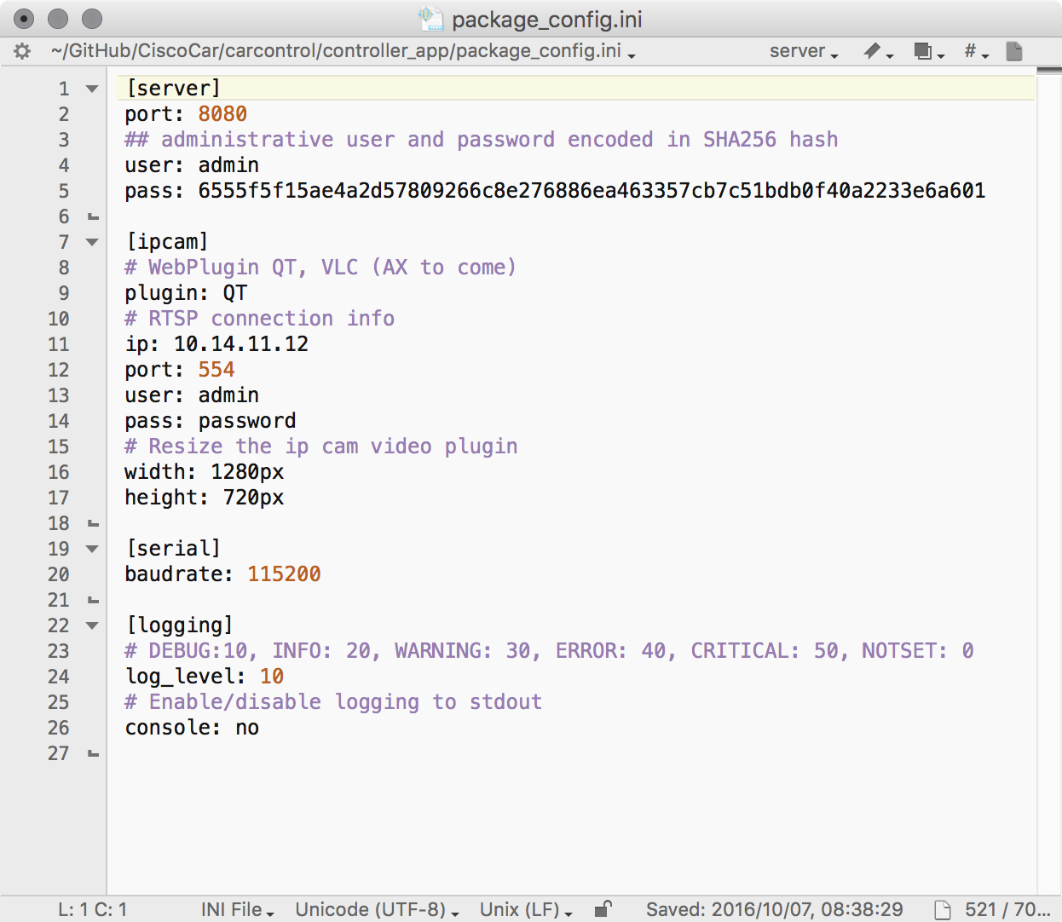
PaaS App Configuration File
Provides flexibility to change settings once the app is deployed
Server port and authentication settings
IP Cam connection details
Serial Baud
Debug/Other logging to troubleshoot app

Slide 10
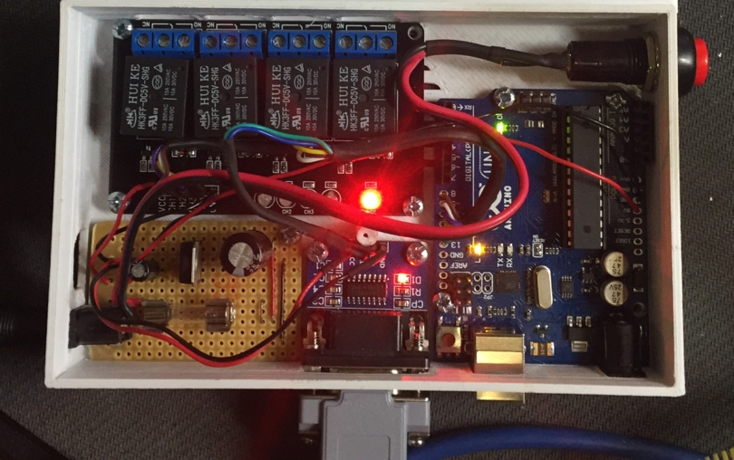
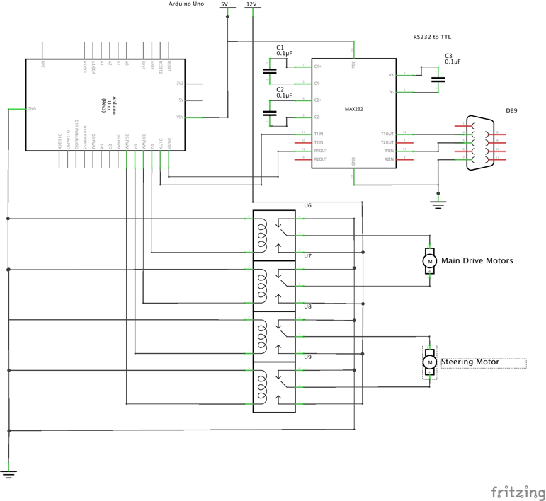
The Electronics
Relays
Arduino
Power Supply
RS232
to TTL

Slide 11
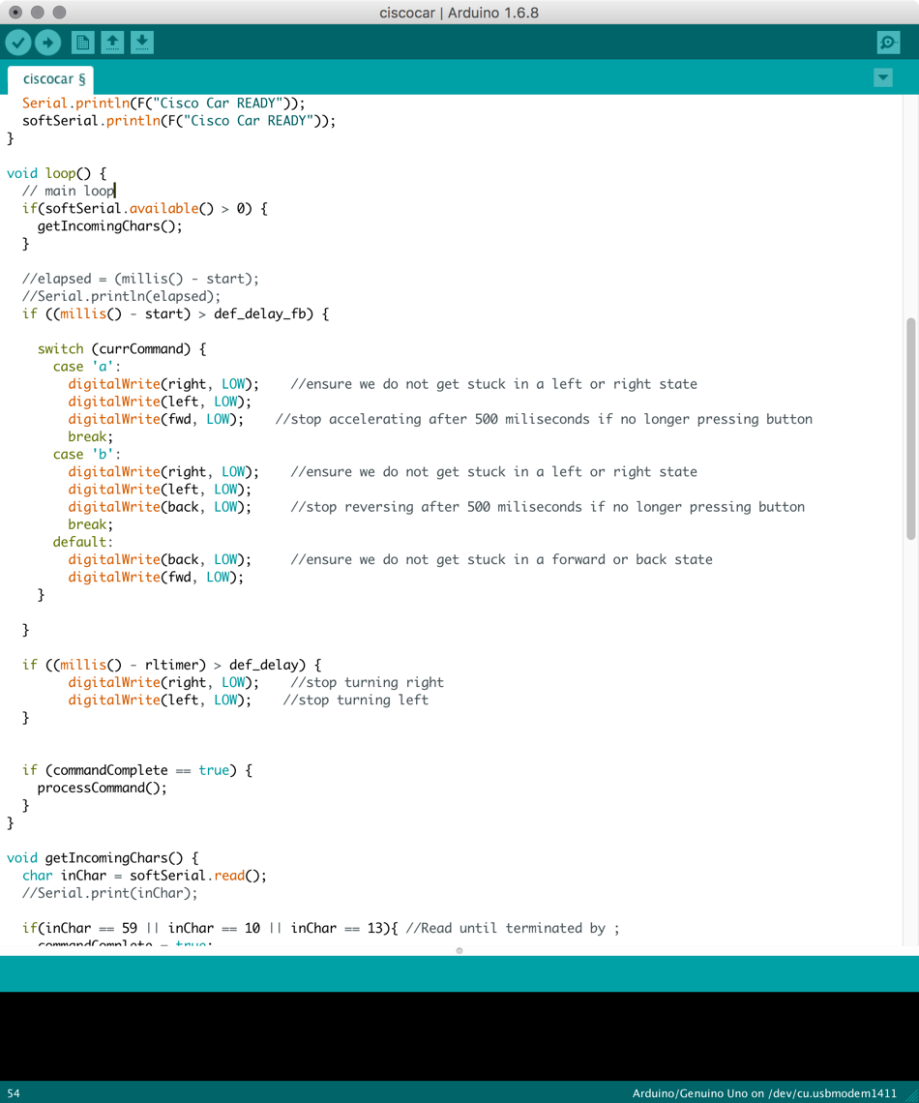
Arduino Microcontroller
Arduino Microcontroller is used to
Switch relays
Provide serial to hardware interface
Firmware
Continually read serial buffer
Detect F,B, L or R commands
Switch correct relay for 500ms

Slide 12
Considerations
This is a simple use example of what can be achieved simply and fairly quickly
The Car is now IP enabled, can control from anywhere world wide as long as there is IP connectivity
Security considerations should be top of mind in development of IOx systems

Slide 13
Questions?

